Slide 1
Presentations
COE 201- Computer Proficiency
Mr. Ahmad Al Kawam

Slide 2
Outline
Short Introduction
View Modes:
Normal
Slide Sorter
Slide Show
Notes Page
Slide Master and Title Master
Inserting Objects:
Diagrams
Charts
Tables
Format Options
Slide Design
Slide Layout
Background
Slide Effects
Slide Animation
Slide Transitions
Running your Slideshow:
Colors and Effects
Slide Hiding
Preparing your slideshow for Packaging
Saving as a Video

Slide 3
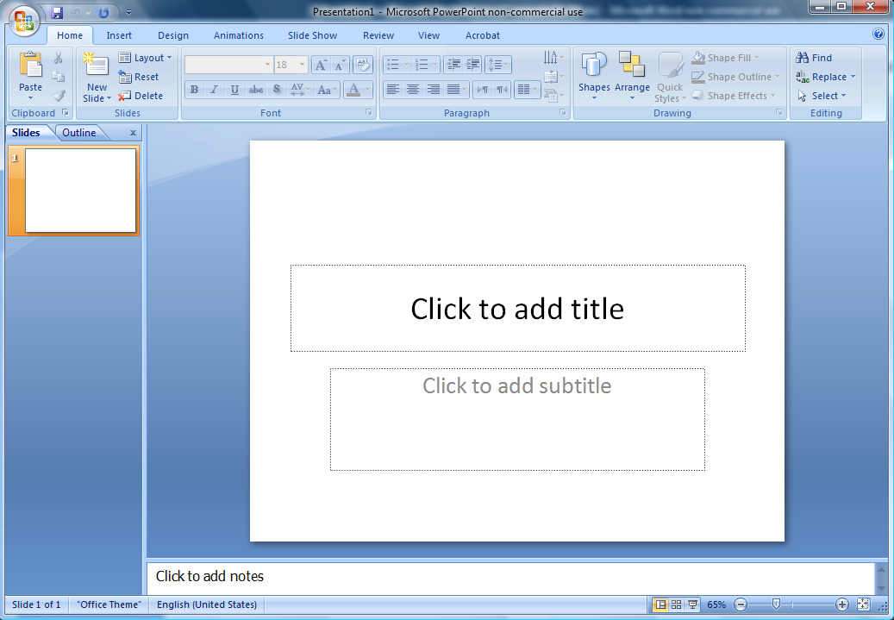
View Mode: Normal
Editing Area
Slide Notes

Slide 4
View Mode: Slide Sorter
Allows you to organize your
slides easier.
You can move, copy, paste and delete one or more slides at the same time.

Slide 5
View Mode: Notes Page
Allows you to write important notes about every slide.
These notes can be printed for rehearsal or distribution to the audience.

Slide 6
View Mode: Slideshow
Displays your presentation covering the whole computer screen
Can be run from several places:
View Slide Show
F5
Slide Show View Show
By clicking on the Show Icon located in the bottom, leftmost area in PowerPoint

Slide 7
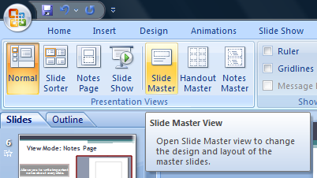
The Slide Master
Slide Master = Slide Template
Two types can be defined:
Slide Master
Title Master
Any change to the slide master will reflect on all the slides in your presentation

Slide 8
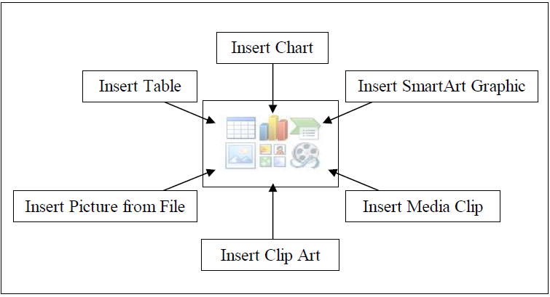
Inserting Objects

Slide 9
Insert Objects: Charts
Found under Insert Chart
Easy alternative to Microsoft Excel
Add more elements in the datasheet or modify existing elements.

Slide 10
Insert Objects: Tables
Found under Insert Table

Slide 11
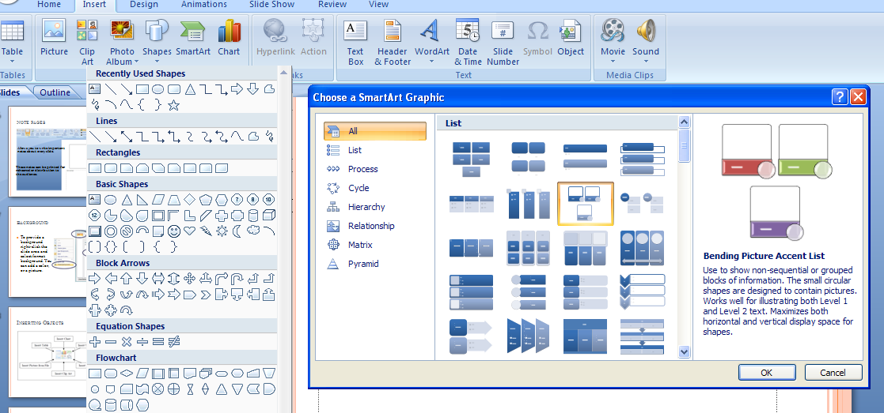
Shapes, Smart Art etc…

Slide 12
Slide Design
Found under: Design
Under the design type you can edit the theme, colors, fonts, effects and other settings.
The design can be modified in the Slide/Title Master

Slide 13
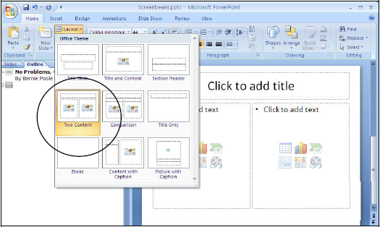
Slide Layout
Found under Home Layout
Allows you to use a preset slide layout for easy ordering on-screen

Slide 14
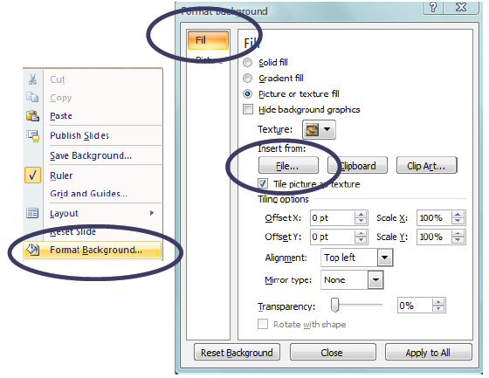
Background
Select a background for one or more slides
Right click on the slide editing area
Select “Format Background”

Slide 15
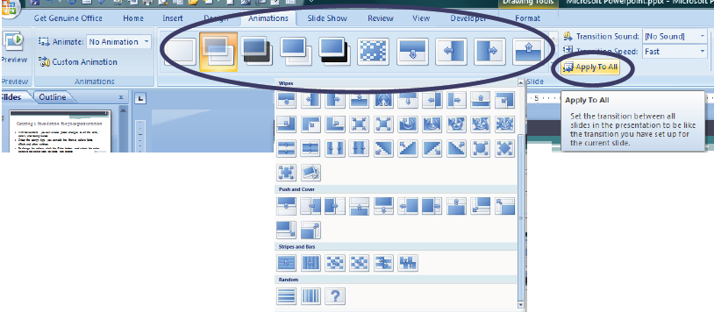
Slide Transitions
Found under Animations
Transition to This Slide
Allows you to add transition effects between every two slides.
Optionally, you can set the slide advancement to ‘automatic’ after a certain time.

Slide 16
Slide Animation
Select any object
Go to “Animations”
select ‘Custom Animation’
You can:
Add an animation
Edit an animation
Time and/or reorganize animations

Slide 17
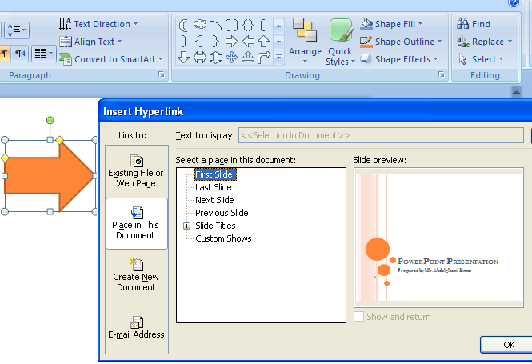
Hyperlinks
Right click on the object and select “Hyperlink”

Slide 18
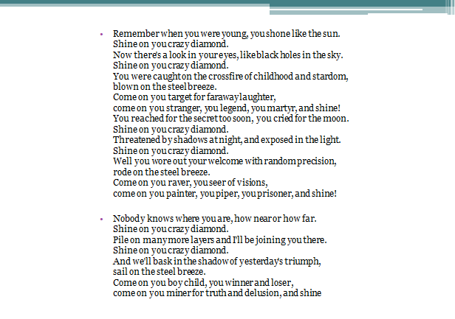
The Slide Show
Never put too much text on your slide!
Careful with the used colors!!
A picture is worth a thousand words!

Slide 19
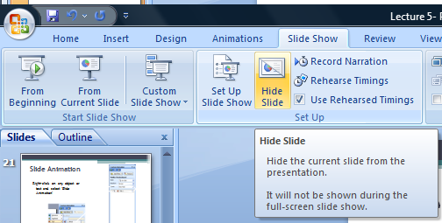
The Slide Show
Slide Hiding

Slide 20
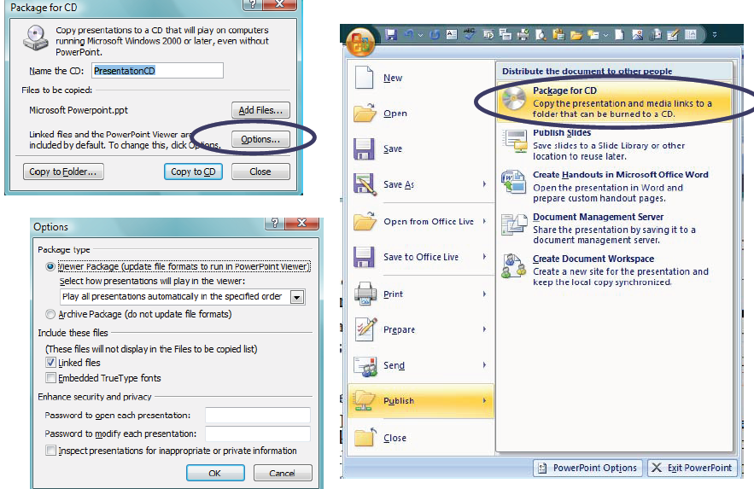
Packaging
The Pack-and-go feature:
Compact format on USB or CD-ROM
Include Fonts and Objects
Include a standalone viewer

Slide 21
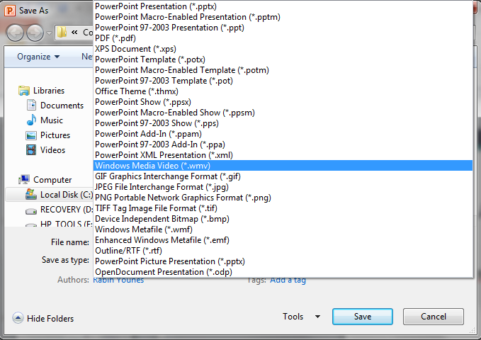
Saving As A Video
Save As…
Select “.wmv” as the type

